Slide 1

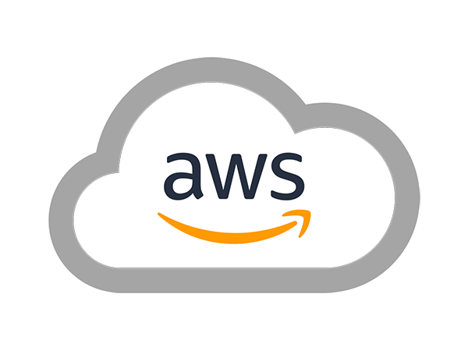
AWS SOLUTIONS ARCHITECT ASSOCIATE
Module 1:
Introduction to AWS

Slide 2
Module Overview
What is Cloud Computing?
AWS Fundamentals
AWS Cloud Computing Platform

Slide 3

Lesson 01: What is Cloud Computing

Slide 4
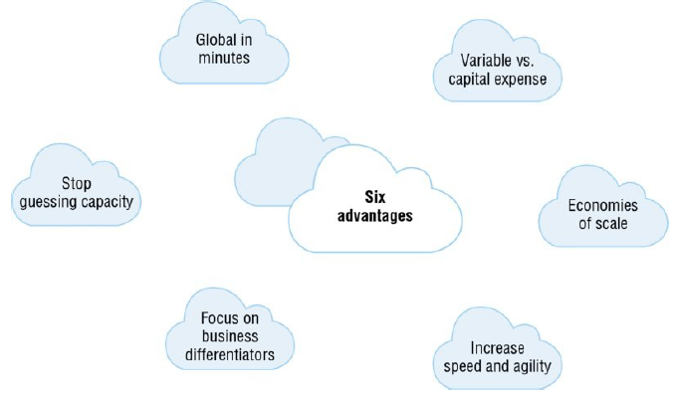
What is Cloud Computing?
Advantages of Cloud Computing
Variable vs. Capital Expense
Economies of Scale
Stop Guessing Capacity
Increase Speed and Agility
Focus on Business Differentiators
Go Global in Minutes

Slide 5


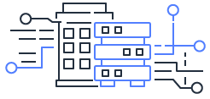
What is Cloud Computing?
Cloud Computing Deployment Models
All-in Cloud-based Application
Hybrid Deployment
Cloud
Hybrid
On-premises
Hybrid Deployment

Slide 6
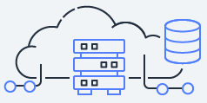
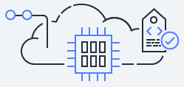

What is Cloud Computing?
Cloud Computing Models
Infrastructure as a Service (IaaS)
Platform as a Service (PaaS)
Software as a Service (SaaS)

Slide 7
Lesson 02: AWS Fundamentals

Slide 8
AWS Fundamentals
  Global Infrastructure
  Security and Compliance
    Security
    Compliance

Slide 9
Lesson 03: AWS Cloud Computing Platform

Slide 10
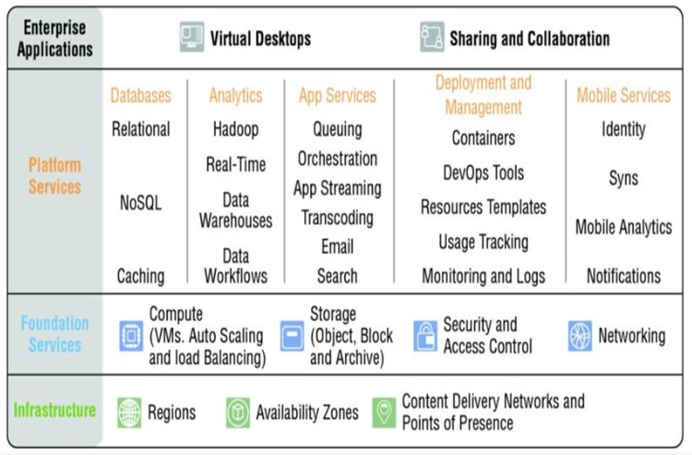
AWS Cloud Computing Platform

Slide 11
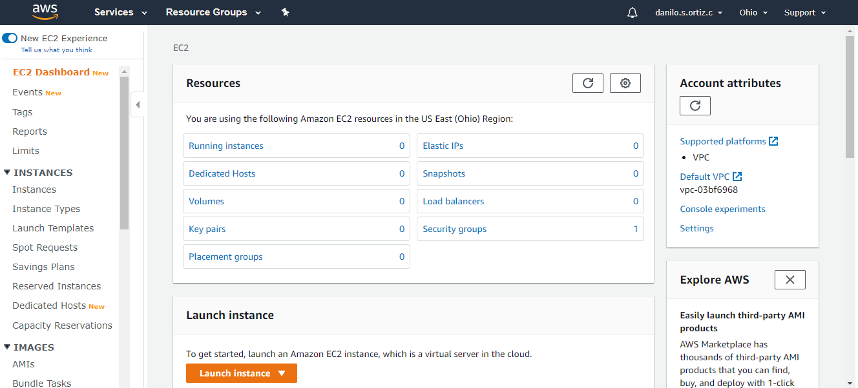
AWS Cloud Computing Platform
Accessing the Platform - AWS Management Console

Slide 12
AWS Cloud Computing Platform
Accessing the Platform - AWS Command Line Interface (CLI)
The AWS Command Line Interface (AWS CLI) uses a multipart structure on the command line that must be specified in this order:
The base call to the aws program.
The top-level command, which typically corresponds to an AWS service supported by the AWS CLI.
The subcommand that specifies which operation to perform.
General CLI options or parameters required by the operation. You can specify these in any order as long as they follow the first three parts.
Open this link https://docs.aws.amazon.com/cli/latest/index.html to get furthermore information regarding AWS CLI

Slide 13
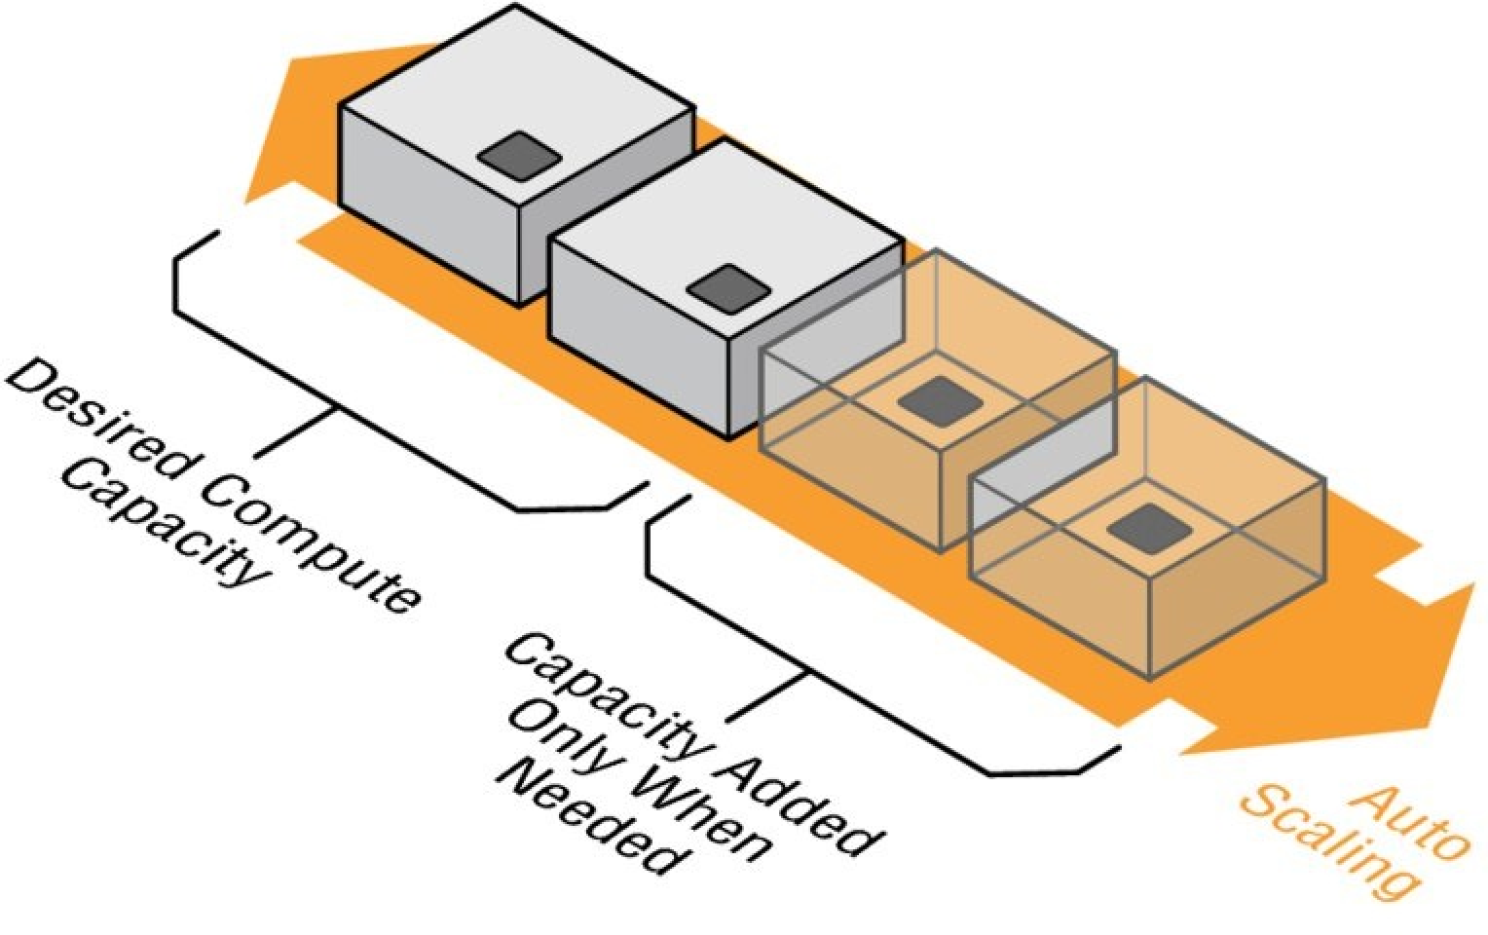
AWS Cloud Computing Platform
Compute and Networking Services
  Amazon Elastic Compute Cloud (Amazon EC2)
  AWS Lambda
  Auto Scaling
  Elastic Load Balancing
  AWS Elastic Beanstalk
  Amazon Virtual Private Cloud
  AWS Direct Connect
  Amazon Route 53

Slide 14
AWS Cloud Computing Platform
Storage and Content Delivery
Amazon Simple Storage Service (Amazon S3)
Amazon Glacier
Amazon Elastic Block Store (Amazon EBS)
AWS Storage Gateway
Amazon CloudFront

Slide 15
AWS Cloud Computing Platform
Database Services
Amazon Relational Database Service (Amazon RDS)
Amazon DynamoDB
Amazon Redshift
Amazon ElastiCache
Amazon CloudFront

Slide 16
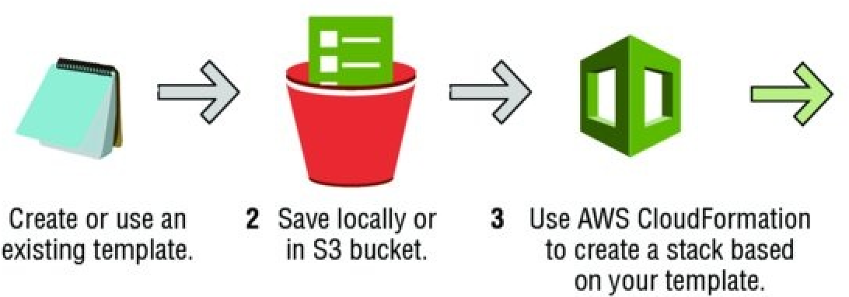
AWS Cloud Computing Platform
Management Tools
Amazon CloudWatch
AWS CloudFormation
AWS CloudTrail
AWS Config

Slide 17
AWS Cloud Computing Platform
Security and Identity
AWS Identity and Access Management (IAM)
AWS Key Management Service (KMS)
AWS Directory Service
AWS Certificate Manager
AWS Web Application Firewall (WAF)

Slide 18
AWS Cloud Computing Platform
Application Services
Amazon API Gateway
Amazon Elastic Transcoder
Amazon Simple Notification Service (Amazon SNS)
Amazon Simple Email Service (Amazon SES)
Amazon Simple Workflow Service (Amazon SWF)
Amazon Simple Queue Service (Amazon SQS)

Slide 19
Lab Module 1

